Slide 1


Modeling the Spread of COVID-19 Using a Logistic Growth Model in MATLAB
EEE 212 (January 2025)
Numerical Technique Laboratory
Prepared by-
Sasshata Talukder
Student ID: 2206136
S. M. Sindid Islam Mahodi
Student ID: 2206147
Rajib Khan
Student ID: 2206152
Iftekhar-E-Islam
Student ID: 2206153

Slide 2
Introduction: Logistics Growth Model & Uploading Data
Sasshata Talukder
Student ID: 2206136

Slide 3
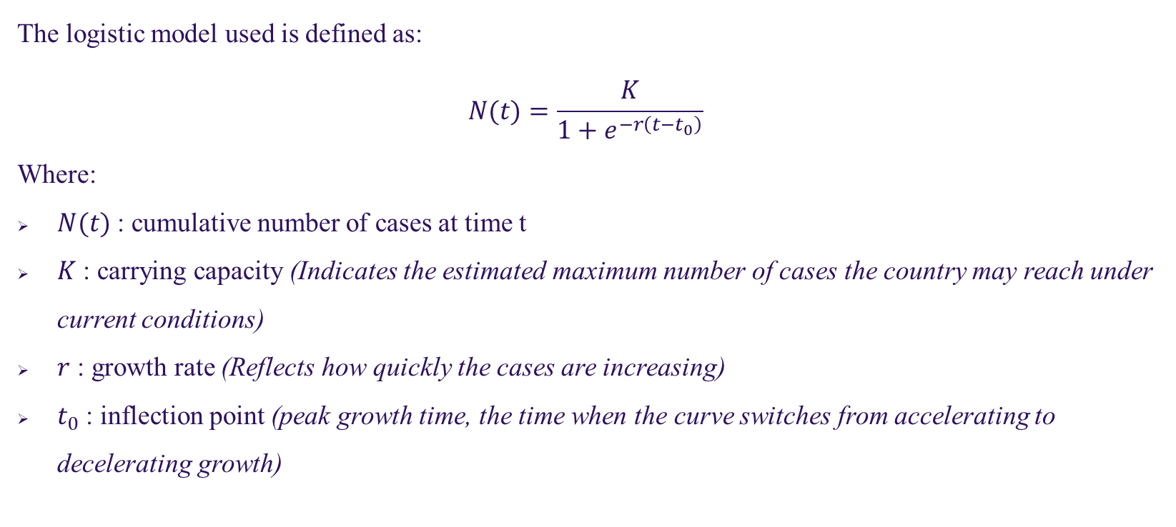
Logistic Growth Model Basics
The logistic model used is defined as:
$$N(t)=\frac{K}{1+e^{−r\left(t−t_{0}\right)}}​$$
Where:
$N(t)$ : cumulative number of cases at time t
$K$ : carrying capacity (Indicates the estimated maximum number of cases the country may reach under current conditions)
$r$ : growth rate (Reflects how quickly the cases are increasing)
$t_{0}$​: inflection point (peak growth time, the time when the curve switches from accelerating to decelerating growth)

Slide 4
The Numerical Engine: Implementing the Levenberg-Marquardt Algorithm
(Using lsqcurvefit function )
S. M. Sindid Islam Mahodi
Student ID: 2206147

Slide 5
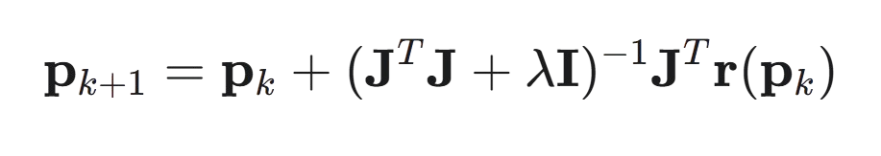





Levenberg-Marquardt Algorithm
This is the new, improved guess for the parameters after taking one step.
This is the current guess for the parameters before taking one step.
This matrix tells us how sensitive the model's output is to small changes in each parameter.
This is a list of the errors between the actual data and the model's prediction using our current guess.
This is the "smart" control knob that adjusts the size and safety of the step the algorithm takes.

Slide 6
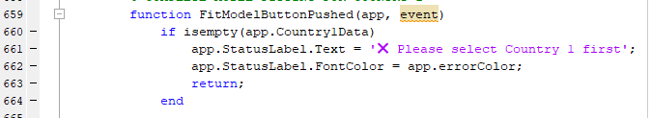
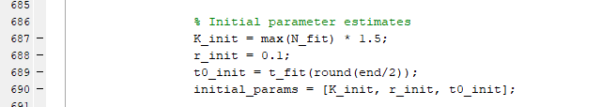
Step – 01: The Starting Point
Purpose: Provide an Initial Guess (p0​), based on the data
K(Carrying Capacity)
= max(N_fit)* 1.5;
r (rate) = 0.1;
to (Inflection) = t_fit(round(end/2));

Slide 7

Step – 02: Constraining the Solution Space
Purpose:
Ensure physically meaningful results
Improve efficiency
Bounds:
Lower:
K must be at least the max observed cases.
r must be positive.
Higher:
Provides a reasonable ceiling to prevent runaway solutions..

Slide 8

Step – 03: Executing The Solver
Purpose:
To execute the Levenberg-Marquardt algorithm with our specified instructions.
The lsqcurvefit function takes
The model function handle (logistic_model)
The initial guess (initial_params)
The data (t_fit, N_fit)
The constraints (lower_bounds, upper_bounds)

Slide 9
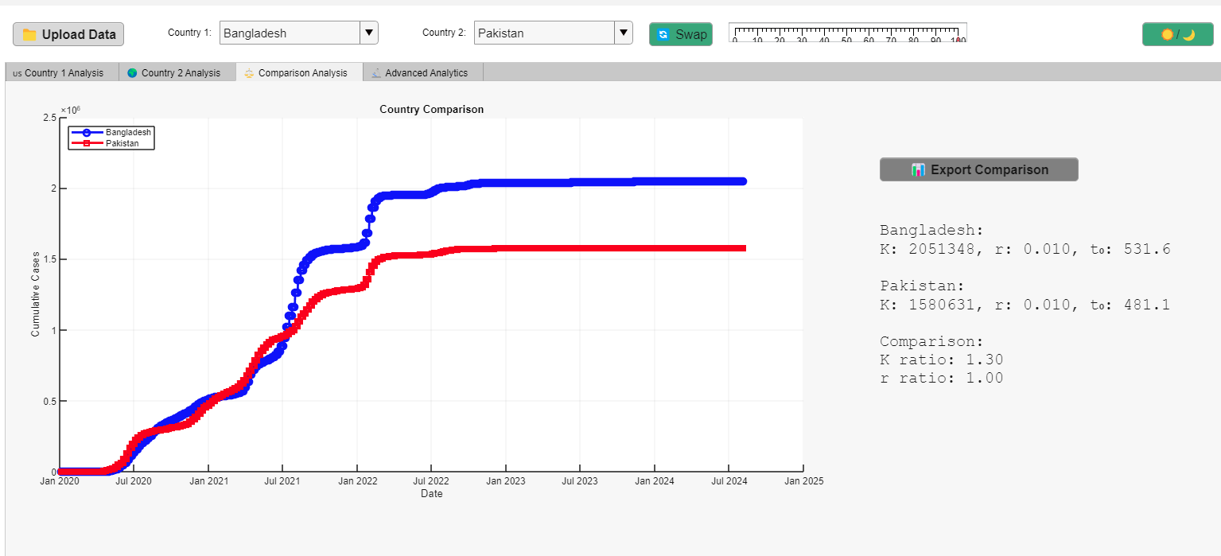
The Comparison Tab
Functionality:
By solving for two countries, we move from simple calculation to analytical insight.
The "Comparison" dashboard visualizes both solutions simultaneously.
Enables direct comparison of key parameters (K, r, t₀) and pandemic trajectories.

Slide 10
Visualizing and Validating The Numerical Solution
Rajib Khan
Student ID: 2206152

Slide 11
How good the curve fit is?
Our Validation Tool: The app's visual dashboard is generated by the plotModelResults function.
Two-Step Validation Process:
Direct visual comparison of the model curve against the actual data.
Numerical validation by analyzing the errors, or "residuals."

Slide 12
What We Plot:
Blue Circles: The actual, raw data points from the CSV file.
Pink Line: Our model's curve fitted to the data.
The Goal: To see how closely the red line tracks the blue circles.
The Result: A close alignment between the line and the data gives us our first confirmation that the model is a good fit.
Code Location: plotModelResults function.

Slide 13
Residual:
Residual = ( Actual – Predicted )
Why Plot Them?: To find hidden patterns in the model's errors.
What We Want to See: A random scatter of points centered around the zero line.
What We Want to Avoid: Any clear pattern (like a U-shape or a trend), which would indicate a flaw in our model.

Slide 14
The PDF Report Exporter:
A one-click "Generate PDF Report" button in the GUI.
Function: GeneratePDFReportButtonPushed
The Key command: exportgraphics
It captures all the plots from our analysis.

Slide 15
Advanced Analytics - GUI explanation from
Iftekhar-E-Islam
Student ID: 2206153

Slide 16
Country dashboard:
Here user can see a selected country’s Actual vs Logistic model, Residuals, Growth rate and K parameter Sensitivity
The key feature is
Growth rate - The growth rate r is a parameter in the logistic model that describes how fast the number of cumulative COVID-19 cases increases over time during the outbreak.
K parameter Sensitivity - It means how changing the value of K affects the shape and behaviour of the logistic curve, while keeping the other parameters fixed

Slide 17
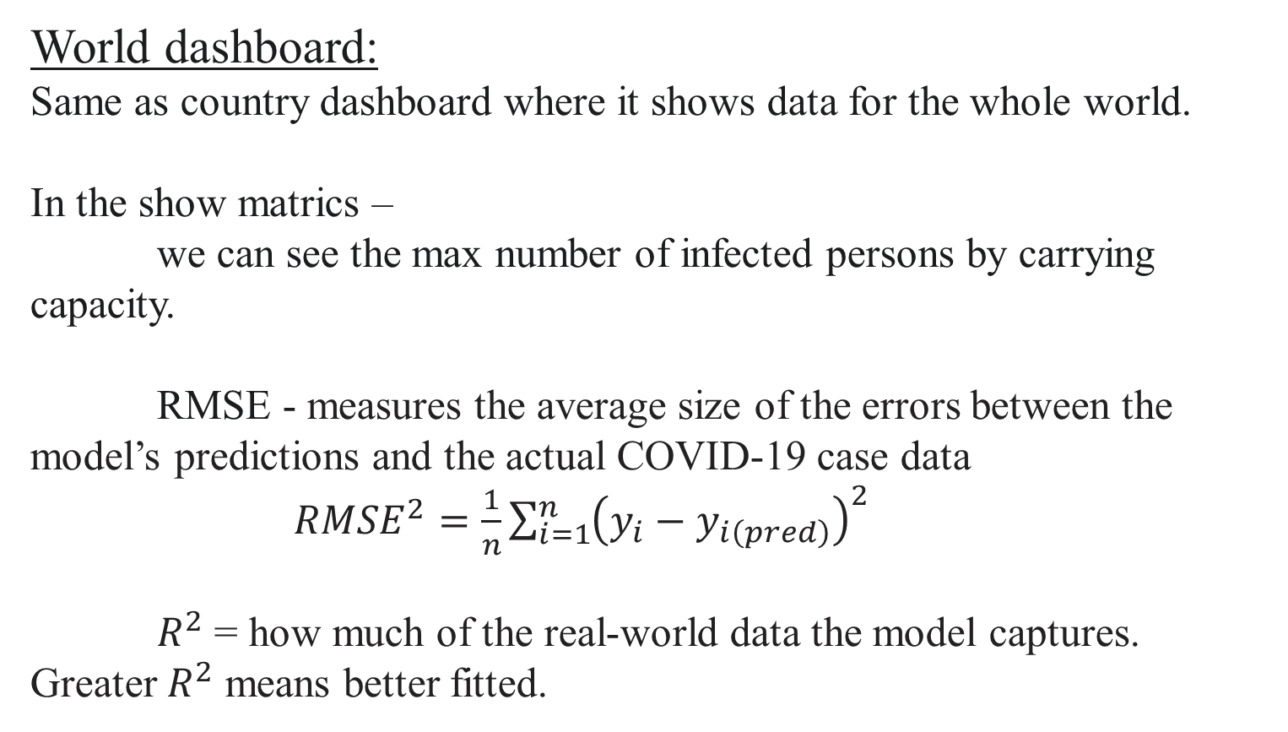
World dashboard:
Same as country dashboard where it shows data for the whole world.
In the show matrics –
we can see the max number of infected persons by carrying capacity.
RMSE - measures the average size of the errors between the model’s predictions and the actual COVID-19 case data $RMSE^{2}=\frac{1}{n}\sum_{i=1}^{n}{{\left(y_{i}−y_{i\left(pred\right)}\right)}^{2}}$
$R^{2}$ = how much of the real-world data the model captures. Greater $R^{2}$ means better fitted.

Slide 18
Date statistics:
It takes date as input and shows Total Infected and Total Deaths
The code
function showDateStats(app)
dtxt = app.AdvDateField.Value; [Reads the text input from the date field]
try
target = datetime(dtxt, 'InputFormat','yyyy-MM-dd’); [Converts the input string into a datetime object]
Catch [ If the conversion fails catch block runs. ]
if ~isempty(app.AdvResultLabel)
app.AdvResultLabel.Text = 'Use YYYY-MM-DD format';
app.AdvResultLabel.FontSize = 20;
if app.isDarkMode
app.AdvResultLabel.FontColor = [1 1 1];
else
app.AdvResultLabel.FontColor = [0.1 0.1 0.1];
end
end
return;
end

Slide 19
Compare countries:
Can compare two countries and observes the
logistic parameters
most fitted curve
saturations

Slide 20
Saturation Date:
Finds saturation date for the first country
Code:
data=extractCountryData(app,c); takes country-specific COVID-19 data
pars=fitLogistic(app,data); fits the logistic model
K=pars.K; Defines the logistic function inline
logistic=@(p,t) p(1)./(1+exp(-p(2)*(t-p(3))));
t_future = linspace(0, max(data.TimeDays)*2, 2000); Extends time into the future to simulate the full curve (2× current duration)
curve = logistic([pars.K pars.r pars.t0], t_future); Computes the logistic curve values over time.
sat95 = 0.95*pars.K; Calculates the 95% saturation threshold.
idx = find(curve>=sat95,1); Finds the first time index when curve reaches 95% of K.
date_sat = data.Date(1)+days(t_future(idx)); converts the predicted time index back into a calendar date
if ~isempty(app.AdvResultLabel)
app.AdvResultLabel.Text = sprintf('%s\nSaturation (95%%)=%.0f\nPredicted Date: %s',c,sat95,datestr(date_sat));
app.AdvResultLabel.FontSize = 20;
if app.isDarkMode
app.AdvResultLabel.FontColor = [1 1 1];
else
app.AdvResultLabel.FontColor = [0.1 0.1 0.1];
end
end
end

Slide 21
Critics and understand the limitations:
While the logistic growth model provides a simple and interpretable way to analyze the cumulative spread of COVID-19, it comes with important limitations.
Single-Wave Assumption
Fixed Parameters
No Real-Time Adaptability
Ignores External Factors
Vaccination campaigns
Virus variants (e.g., Delta, Omicron)
Travel restrictions or reopening policies
Oversimplification
Assumes Accurate Data
Fails in Early/Flat Regions
As a result, its predictions may lose accuracy in highly dynamic or unpredictable settings. Residual patterns and parameter sensitivity help reveal these limitations, highlighting the need for caution when interpreting long-term forecasts.

Slide 22
Tentative way to overcome some limitations
Using Multi-Wave Models
Incorporate External Factors
Switch to Epidemiological Models
Hybrid Modelling
Incorporating these models and factors will lead to more accurate and realistic predictions.

Slide 23
The end
Thank you

Slide 24
For any queries
Contact –
2206136@eee.buet.ac.bd
2206147@eee.buet.ac.bd
2206152@eee.buet.ac.bd
2206153@eee.buet.ac.bd

